Slide 1

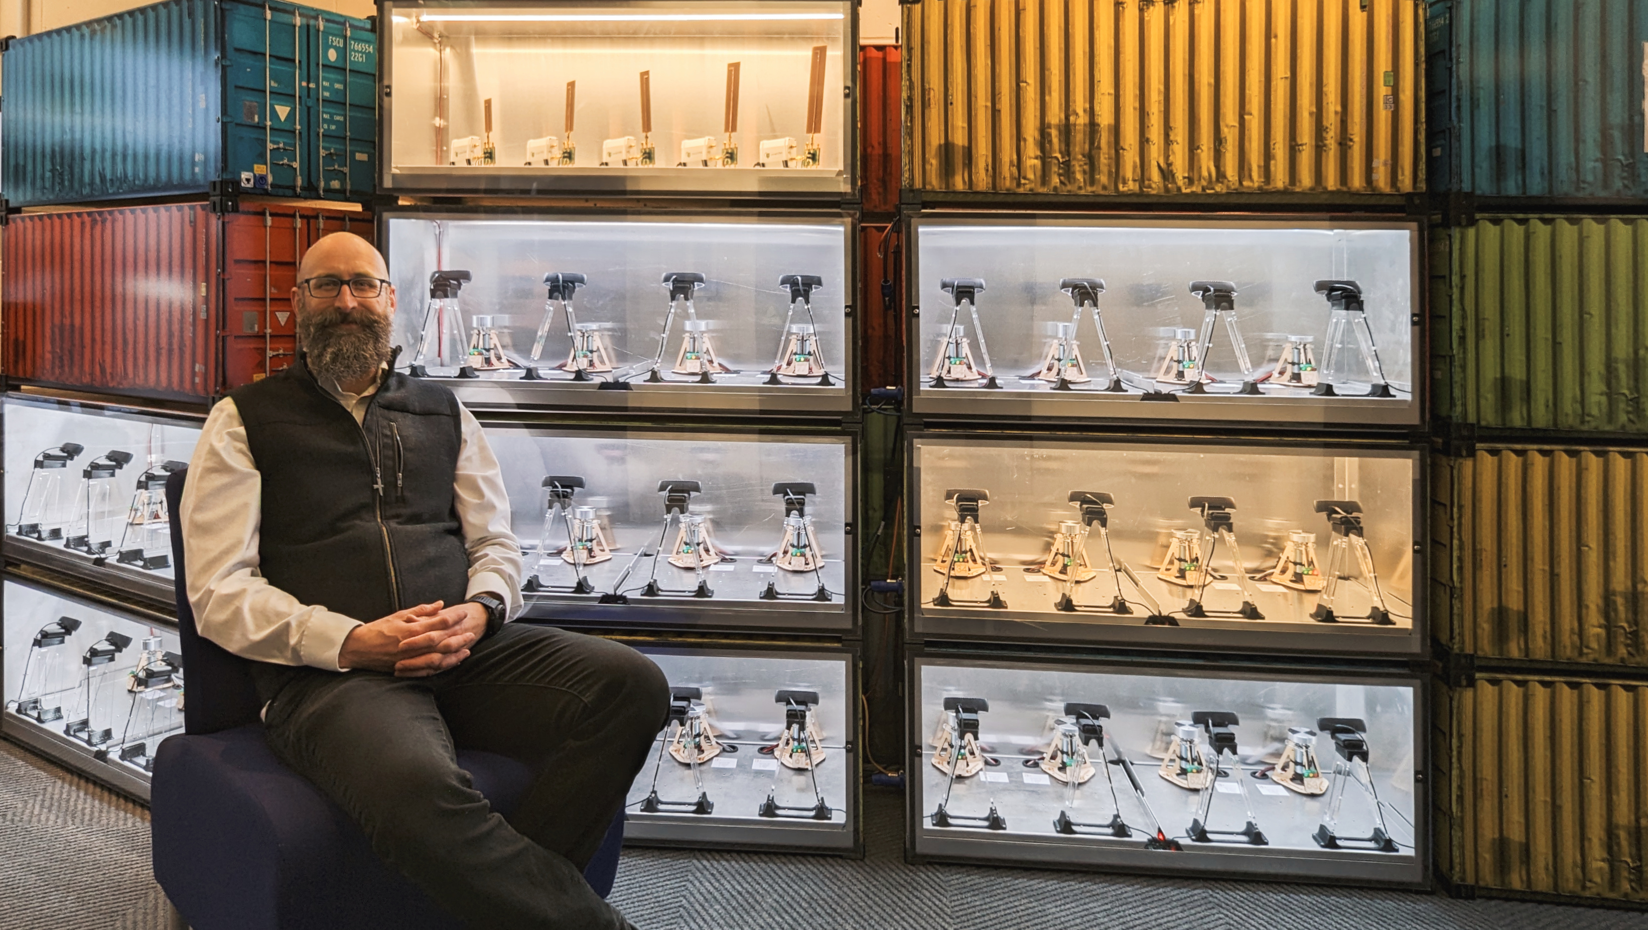
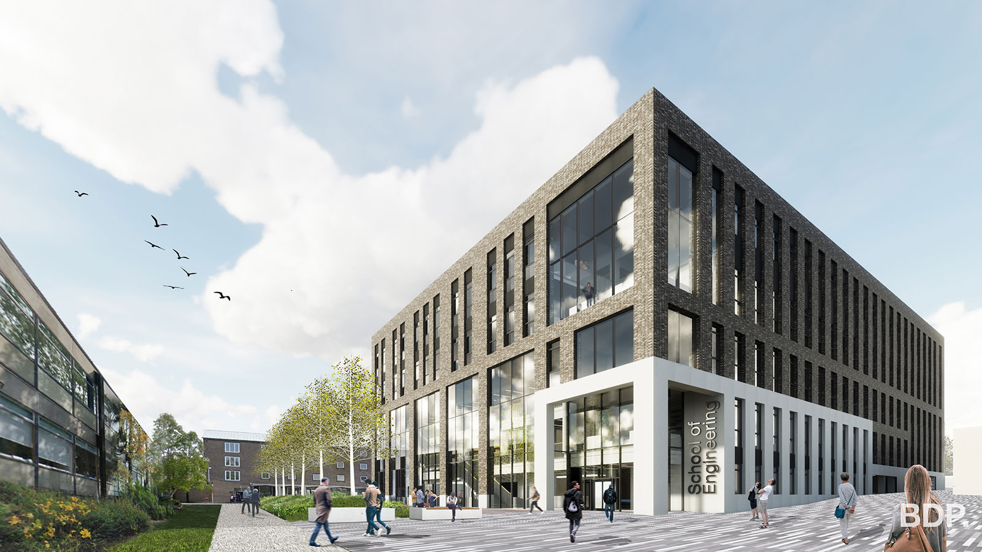

Scaling out STEAM practical work
Prof Timothy Drysdale
Director of Strategic Digital Education
Chair of Technology Enhanced Science Education
Notes:
1

Slide 2
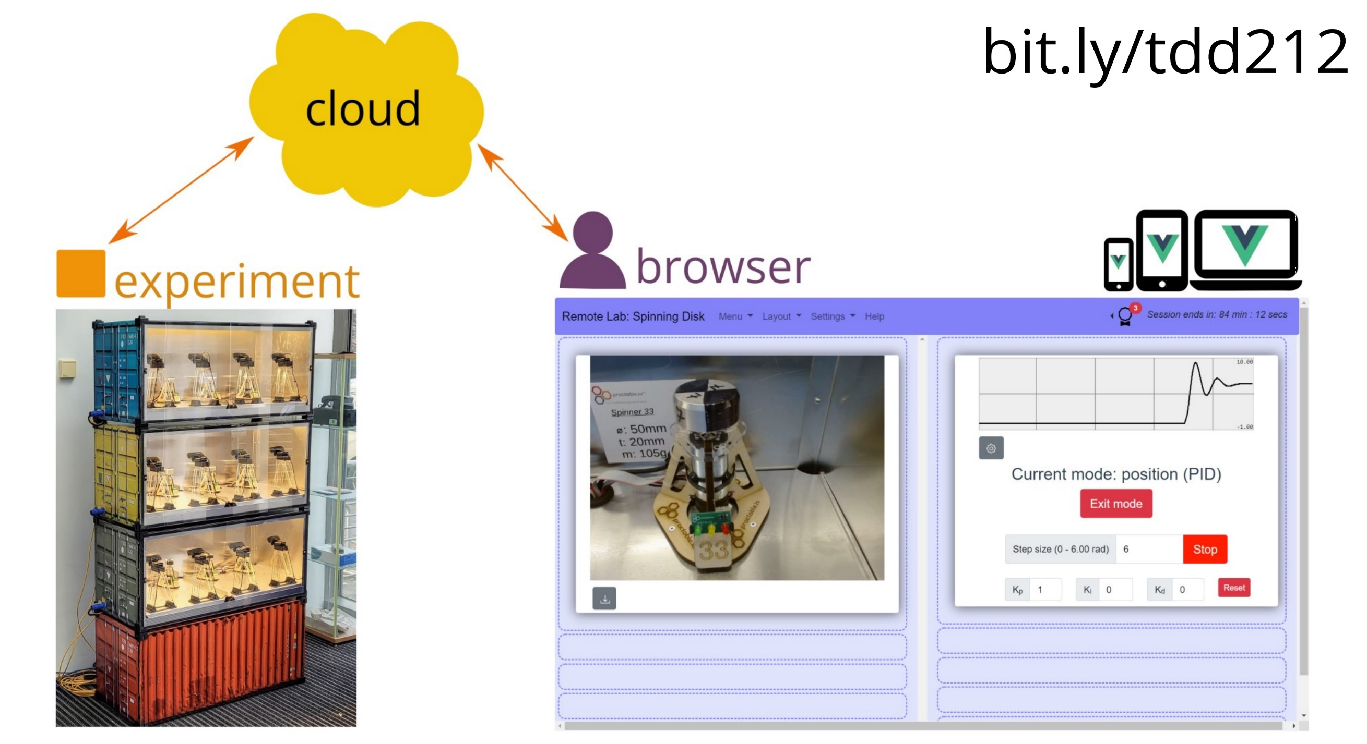
Students use a browser to access equipment in real-time
Notes:
2

Slide 3
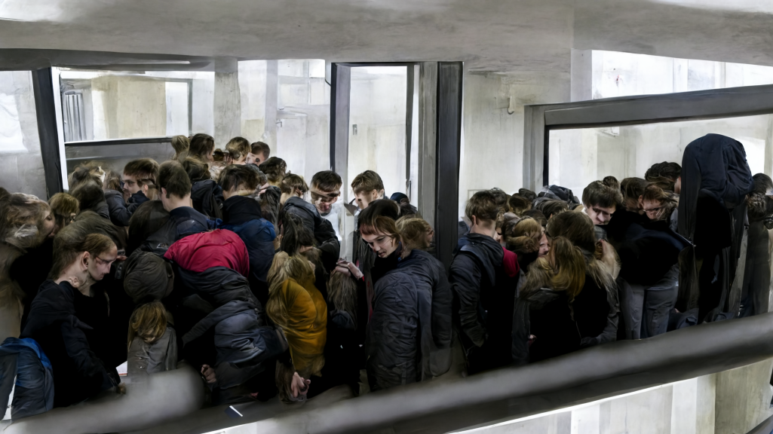
“Waiting for a lab session”
2018
Credit – Tim Drysdale using Midjourney AI
Notes:
3

Slide 4
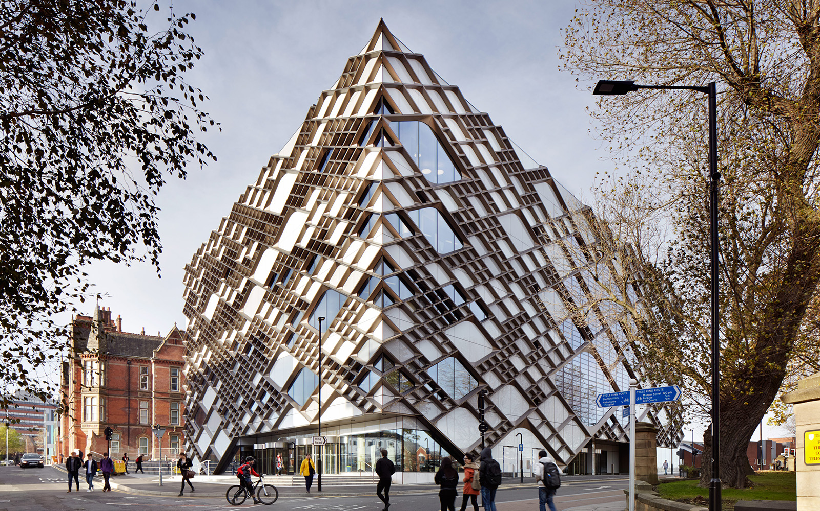
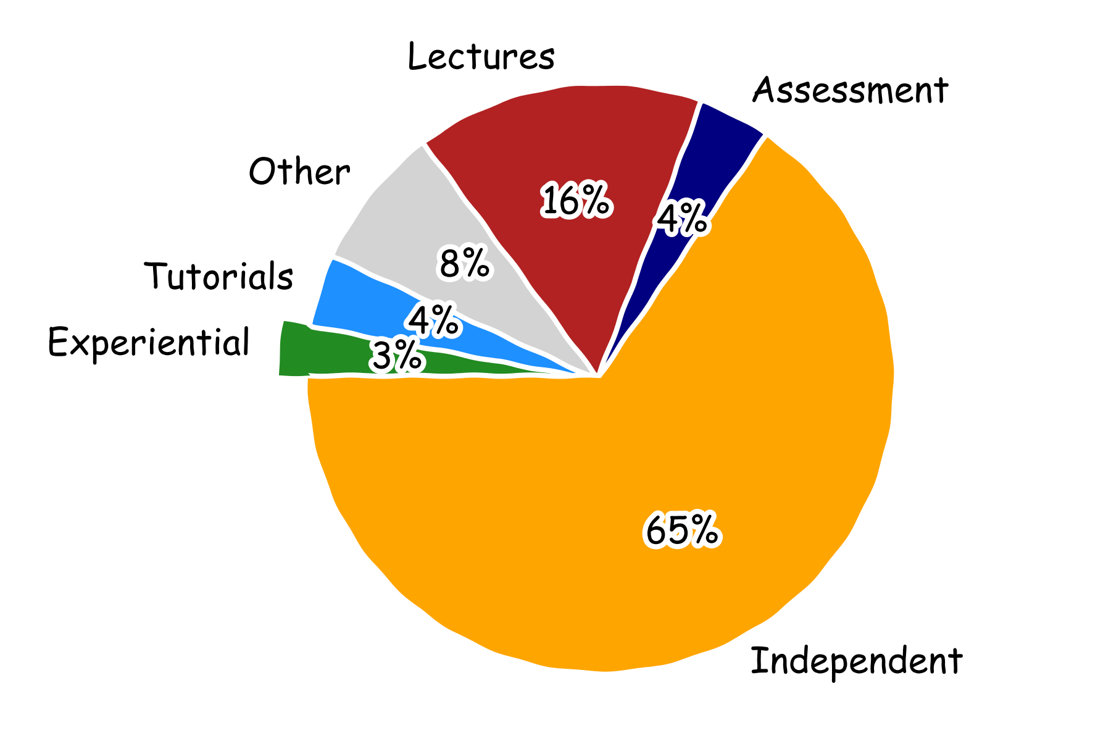
The Diamond,
University of Sheffield, 2015
~£90M Capital
19 Labs, 50 Staff
Serves 5000 students
Aggregate of courses in an engineering school (not Sheffield) with publicly-available course data

Slide 5

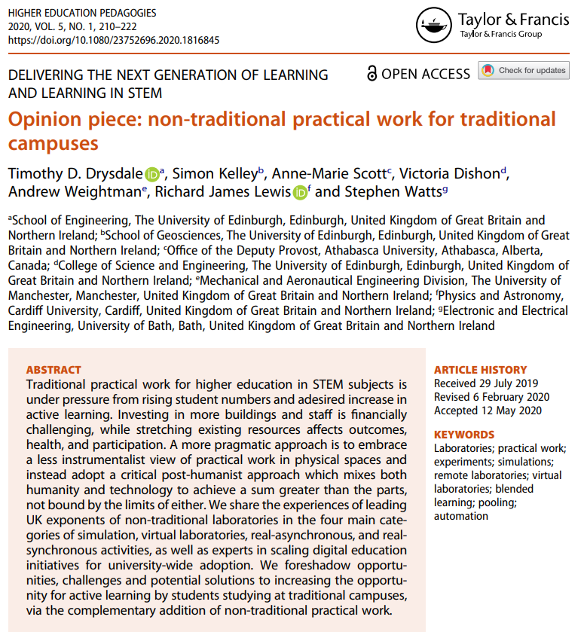

2019
Notes:
https://www.tandfonline.com/doi/full/10.1080/23752696.2020.1816845

Slide 6
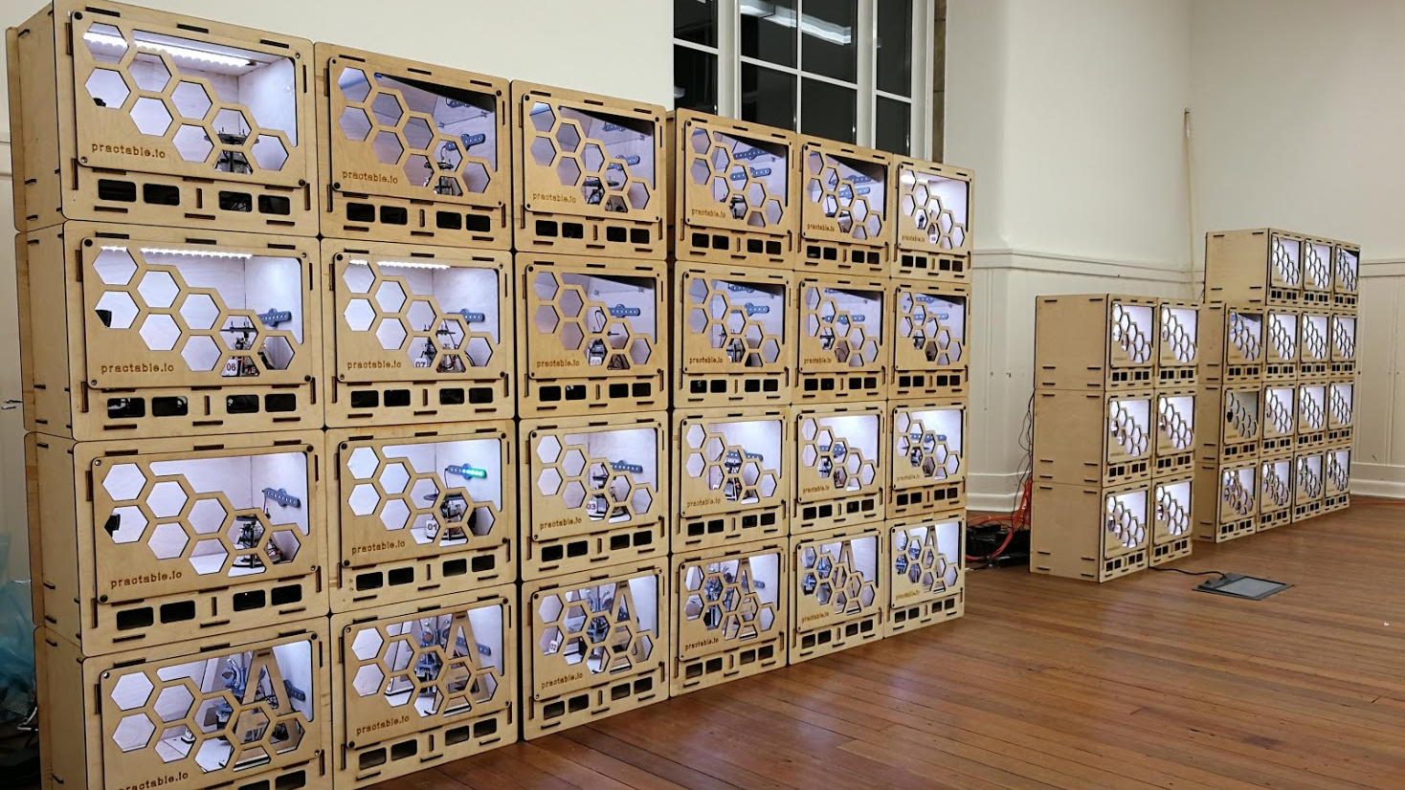
trad | remote | improvement
125 1:1 hrs | 2500 1:1 hrs | 20×
2020
Generation 1

Slide 7
Estates efficiency (>150×)
 | traditional | remote | improvement
Opening hours | 10 hrs / day | 24 hrs / day | 2×
Footprint | >1.5m² | <0.1m² | 15×
Stacking | 1 per area | 5 per area | 5×

Slide 8
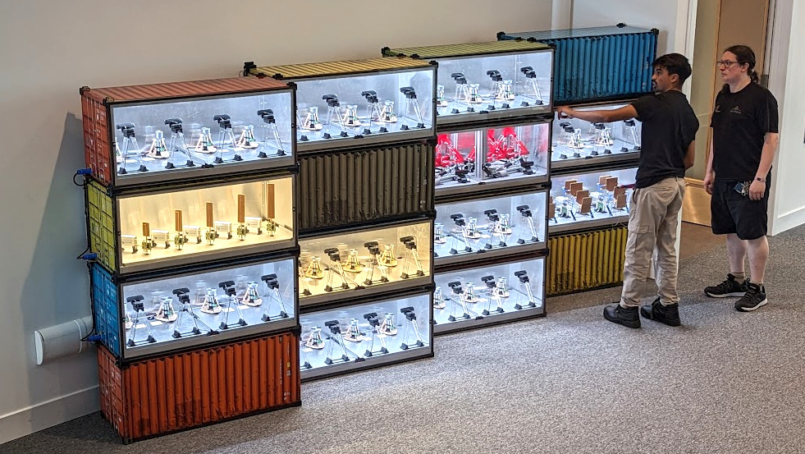
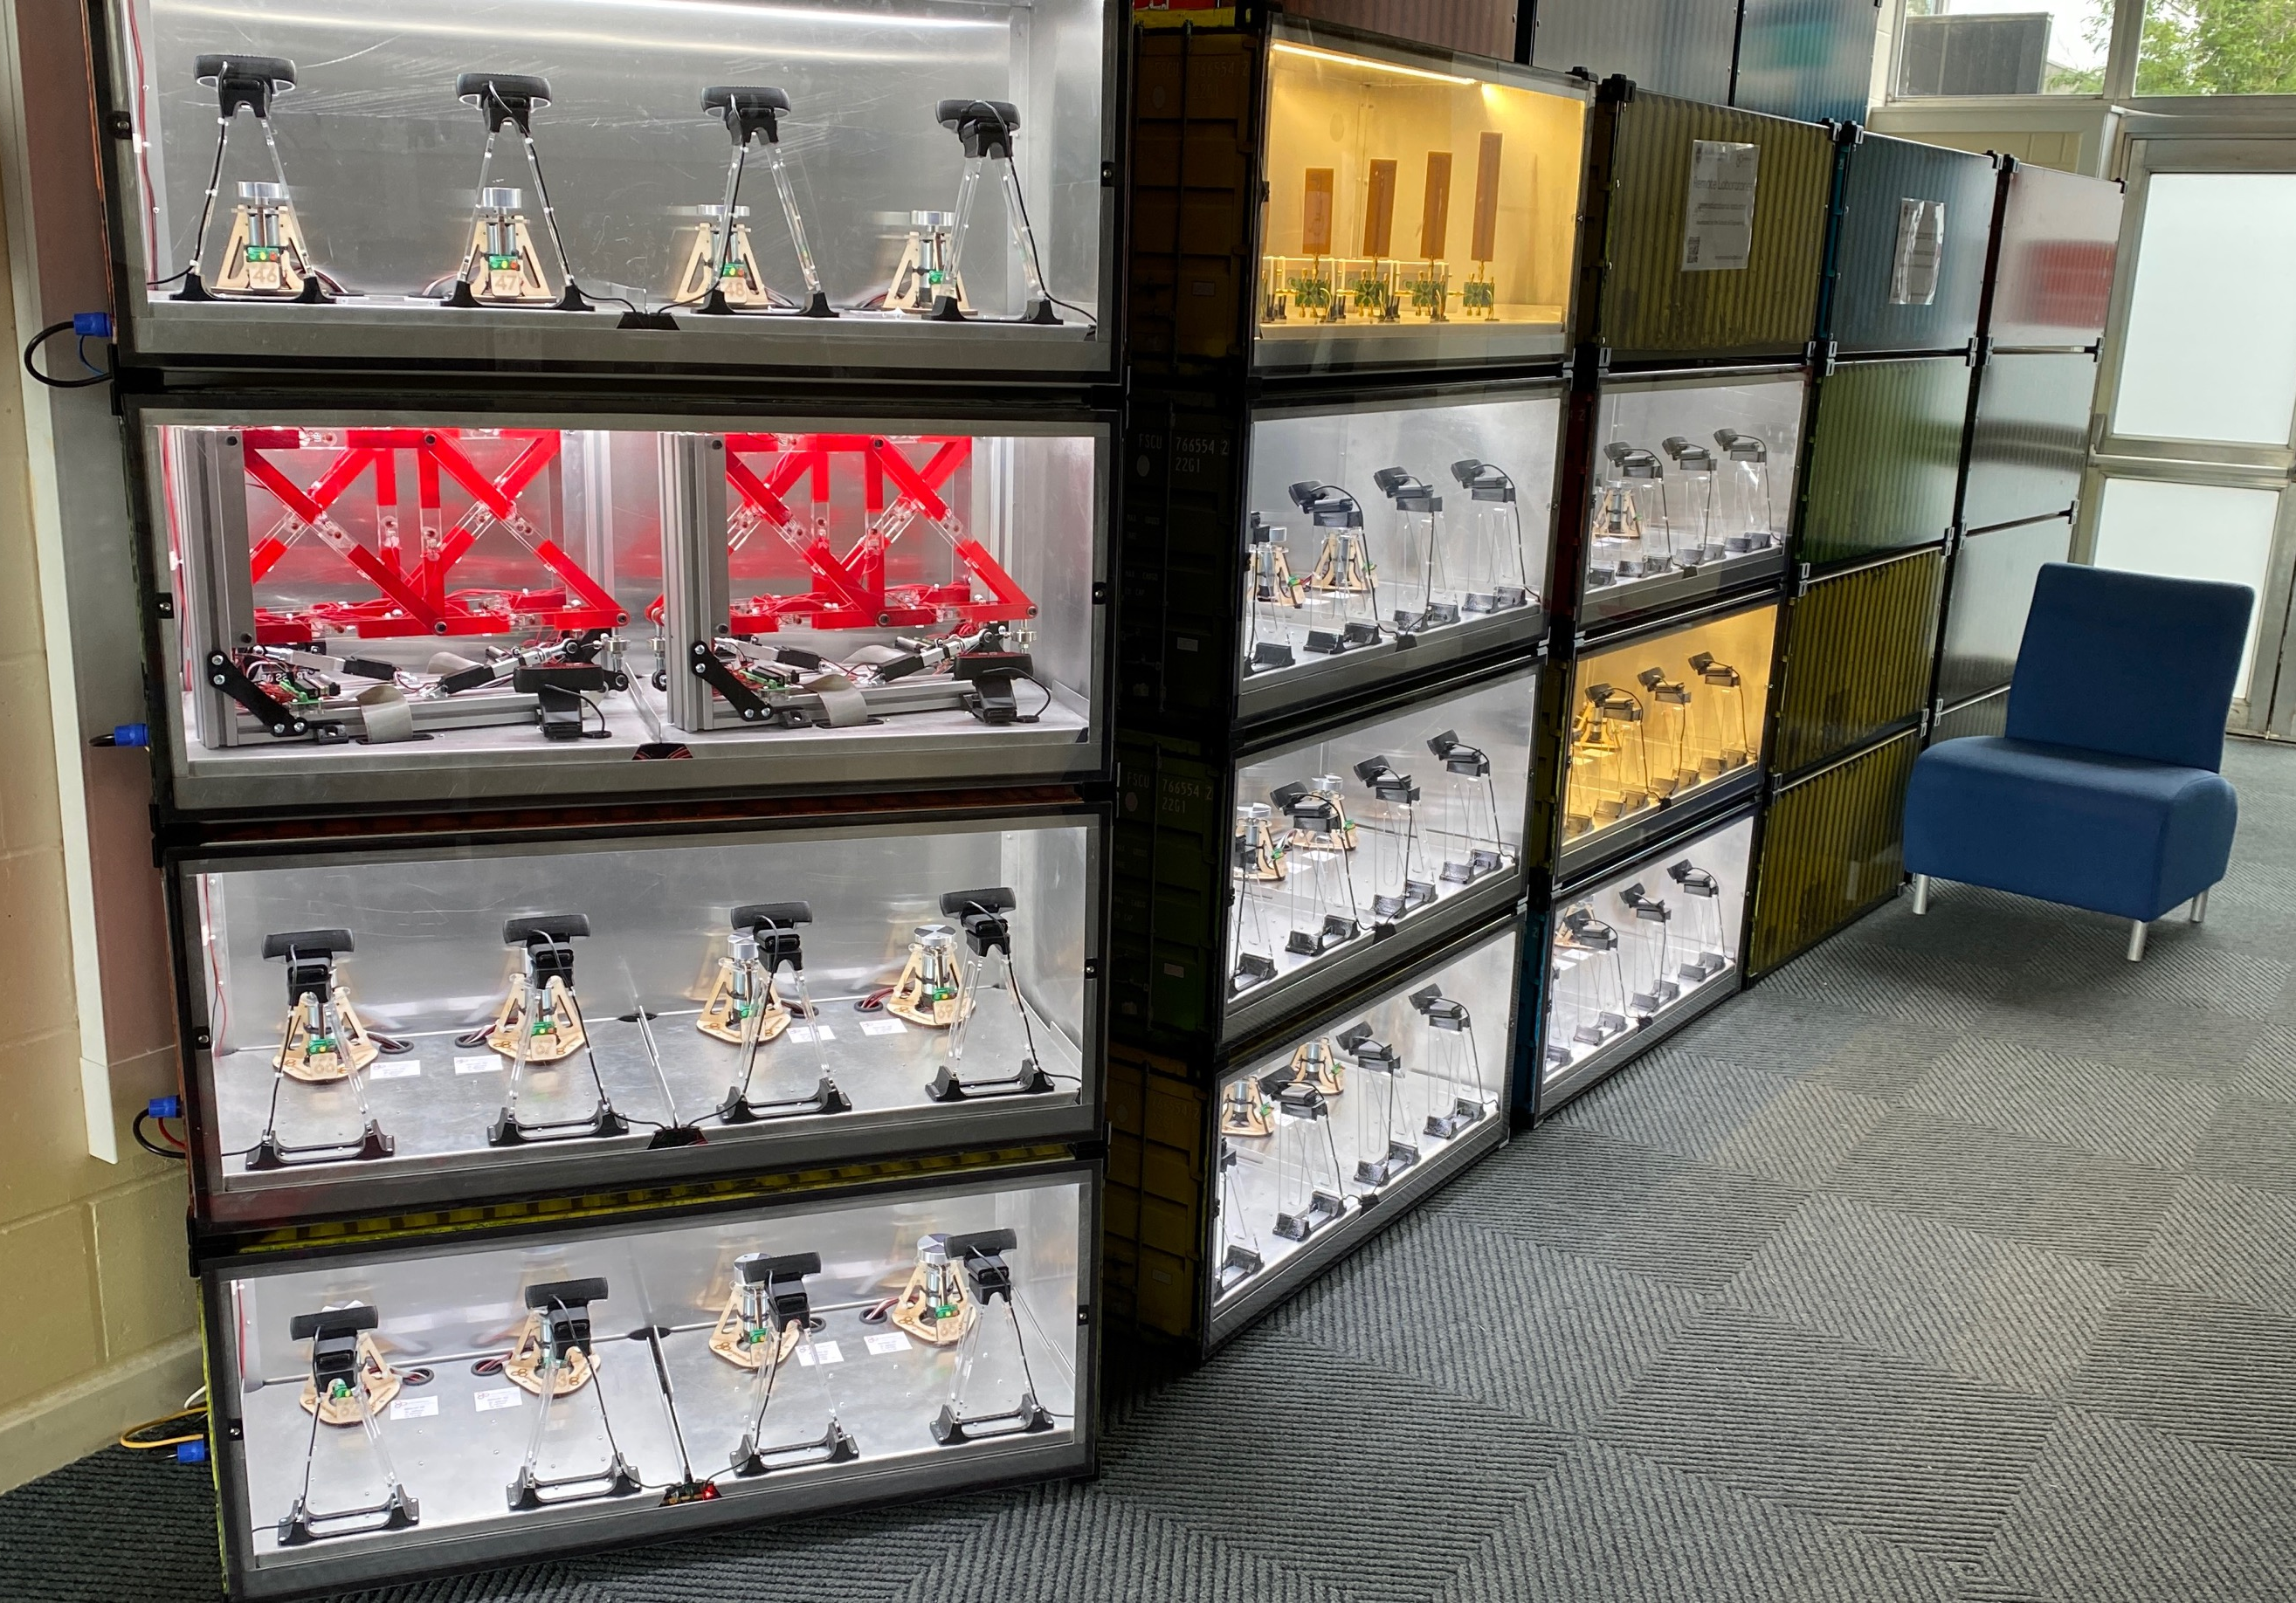
Add value to existing real estate
New generation can be hosted in public foyers
Does not take up any teaching or research laboratory space
Only needs power and data sockets
Adds an attractive “science museum” feel to campus
Students can visit experiments when on campus
Increases visibility of activities to visitors, and internally
2021

Slide 9
2022
Generation 2

Slide 10
Remote labs direct contributors (>20)
Delivery team: Andrew Brown, Imogen Heard, Calum Melrose, and seven interns + recruiting soon
PhD Researchers: David Reid, Sijie Zhou, + recruiting now
Course staff: Aristides Kiprakis, Michael Merlin, Jonathan Terry, Brian Peterson, Thomas Reynolds, Marcelo Dias, Symon Podilchak & research team.
Project lead (& core software – for now): Timothy Drysdale
Funded by the School of Engineering

Slide 11
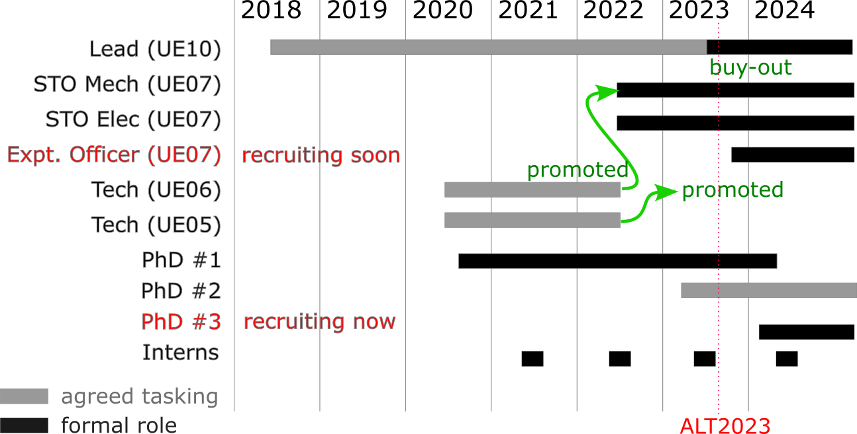

Slide 12
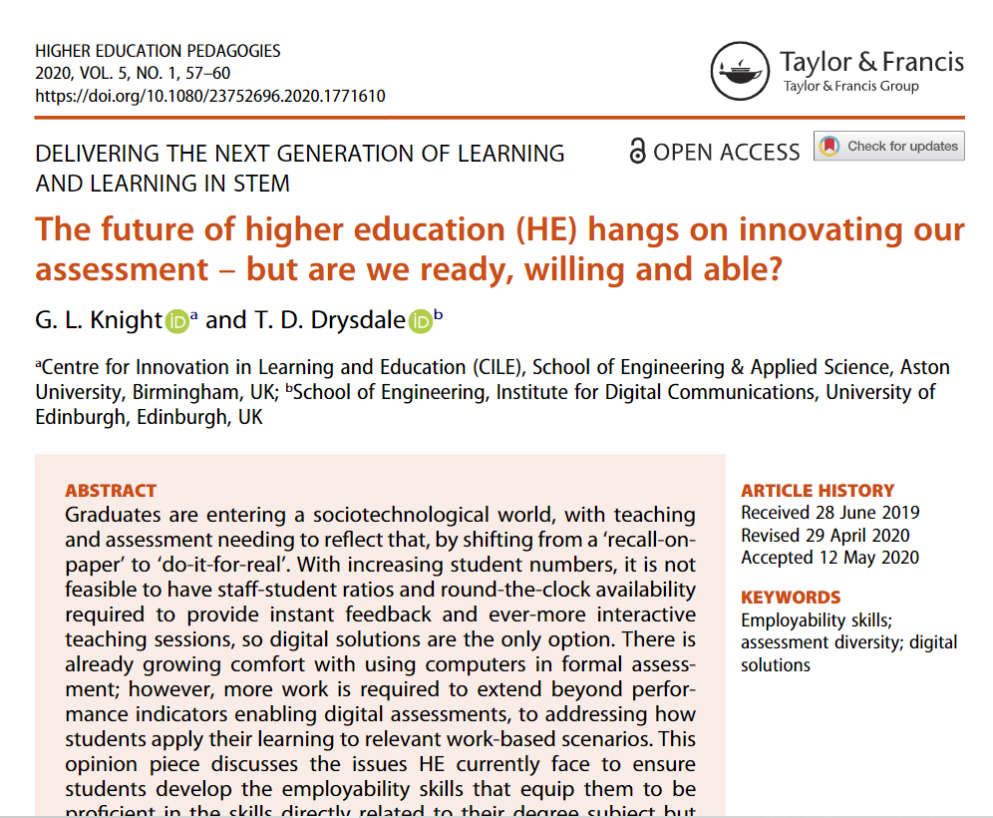
EXTERNAL
FACTORS

Slide 13
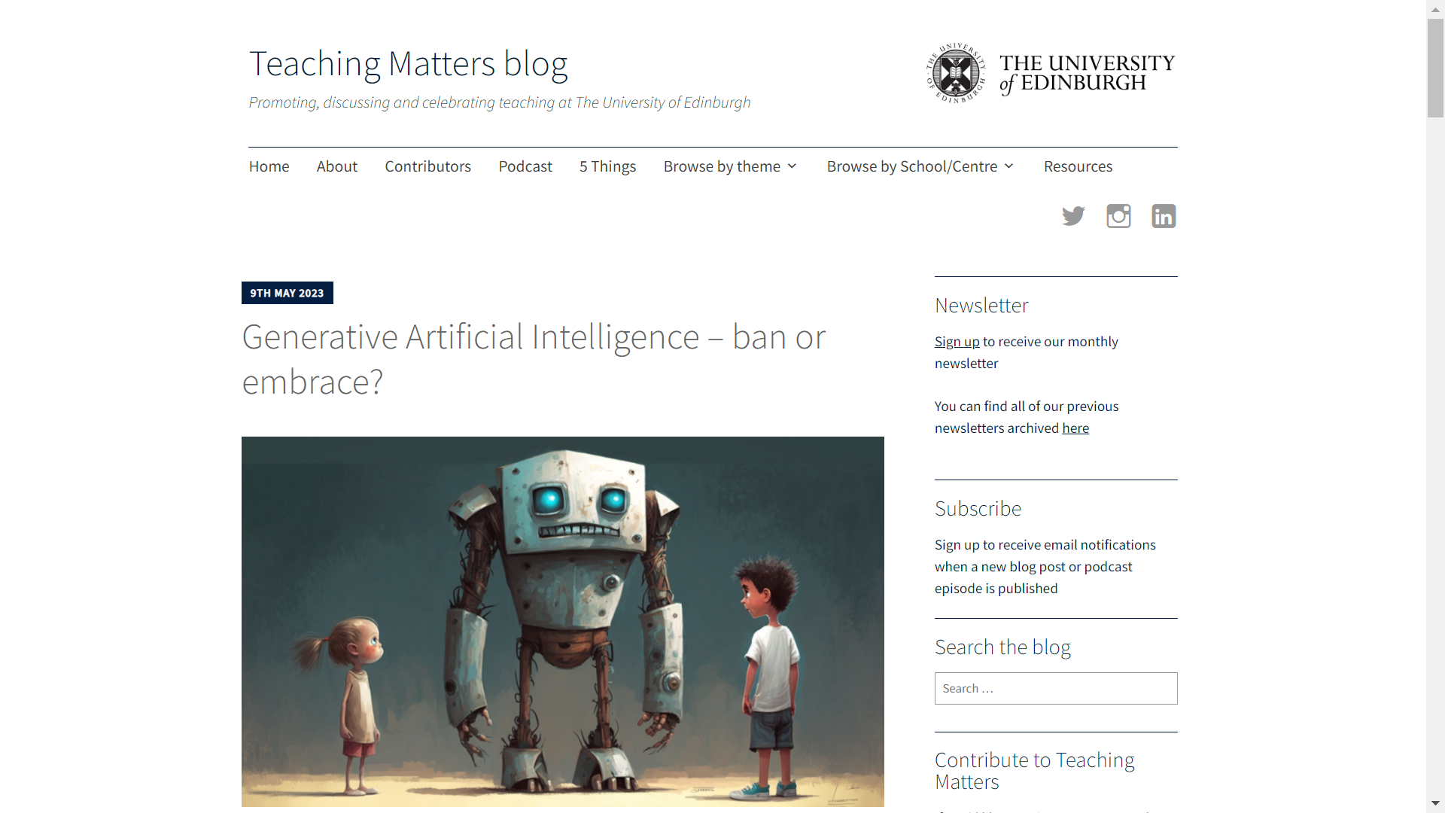
External influences
EXTERNAL
FACTORS
bit.ly/tdtmboe

Slide 14
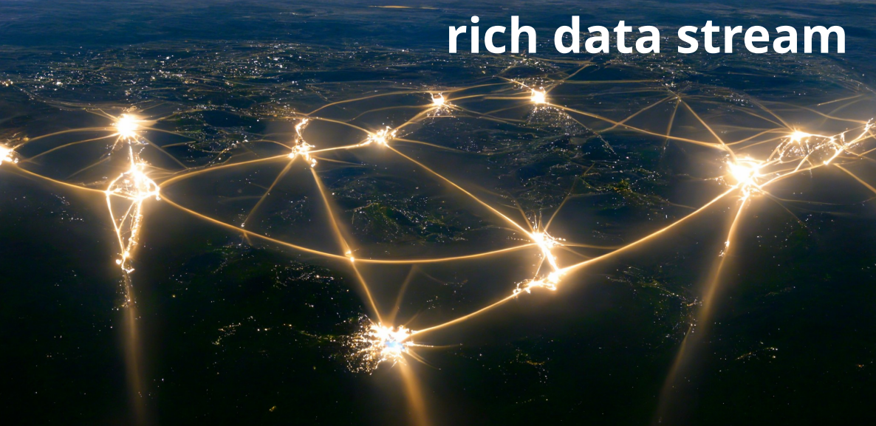
Authentic assessment in a world with LLM
Cost-effective to assess PROCESS (not just output)

Slide 15
Open source / Rent / Buy / Commission
Schedule a demonstration session: timothy.drysdale@ed.ac.uk

Slide 16
Extra Slides

Slide 17
Benefits of remote labs
Add capacity for practical work at low cost
150x more estates-efficient than traditional labs
Faster to build than a new laboratory
Avoid timetable issues
Support EDI initiatives by being more flexible
Prepare for future developments
Increase graduate skills through additional experiential learning
Enable authentic assessment of (iterative) engineering tasks
Embrace large language models by measuring process not output

Slide 18
Feedback on demand
Effective learning involves discomfort
Feedback and support required to maintain student engagement through beneficial difficulties
Automated feedback available on demand required for asynchronous activities
Recent research results are very encouraging
Work is under preparation for publication

Slide 19
Traditional campus uses (so far)
Timetabled
staff and students in same room at same time
can be any teaching room (students can BYOD)
equipment is remote (stays in its usual location, e.g. building foyer)
Independent
staff set task(s)
students book at a time to suit them
students submit a technical report for assessment
Demonstration
Staff member shows live experiment in class, outreach, or offer holder day
Dissemination of research*
Add to EPSRC grant as way to instantly reach industry/public with research demo

Slide 20
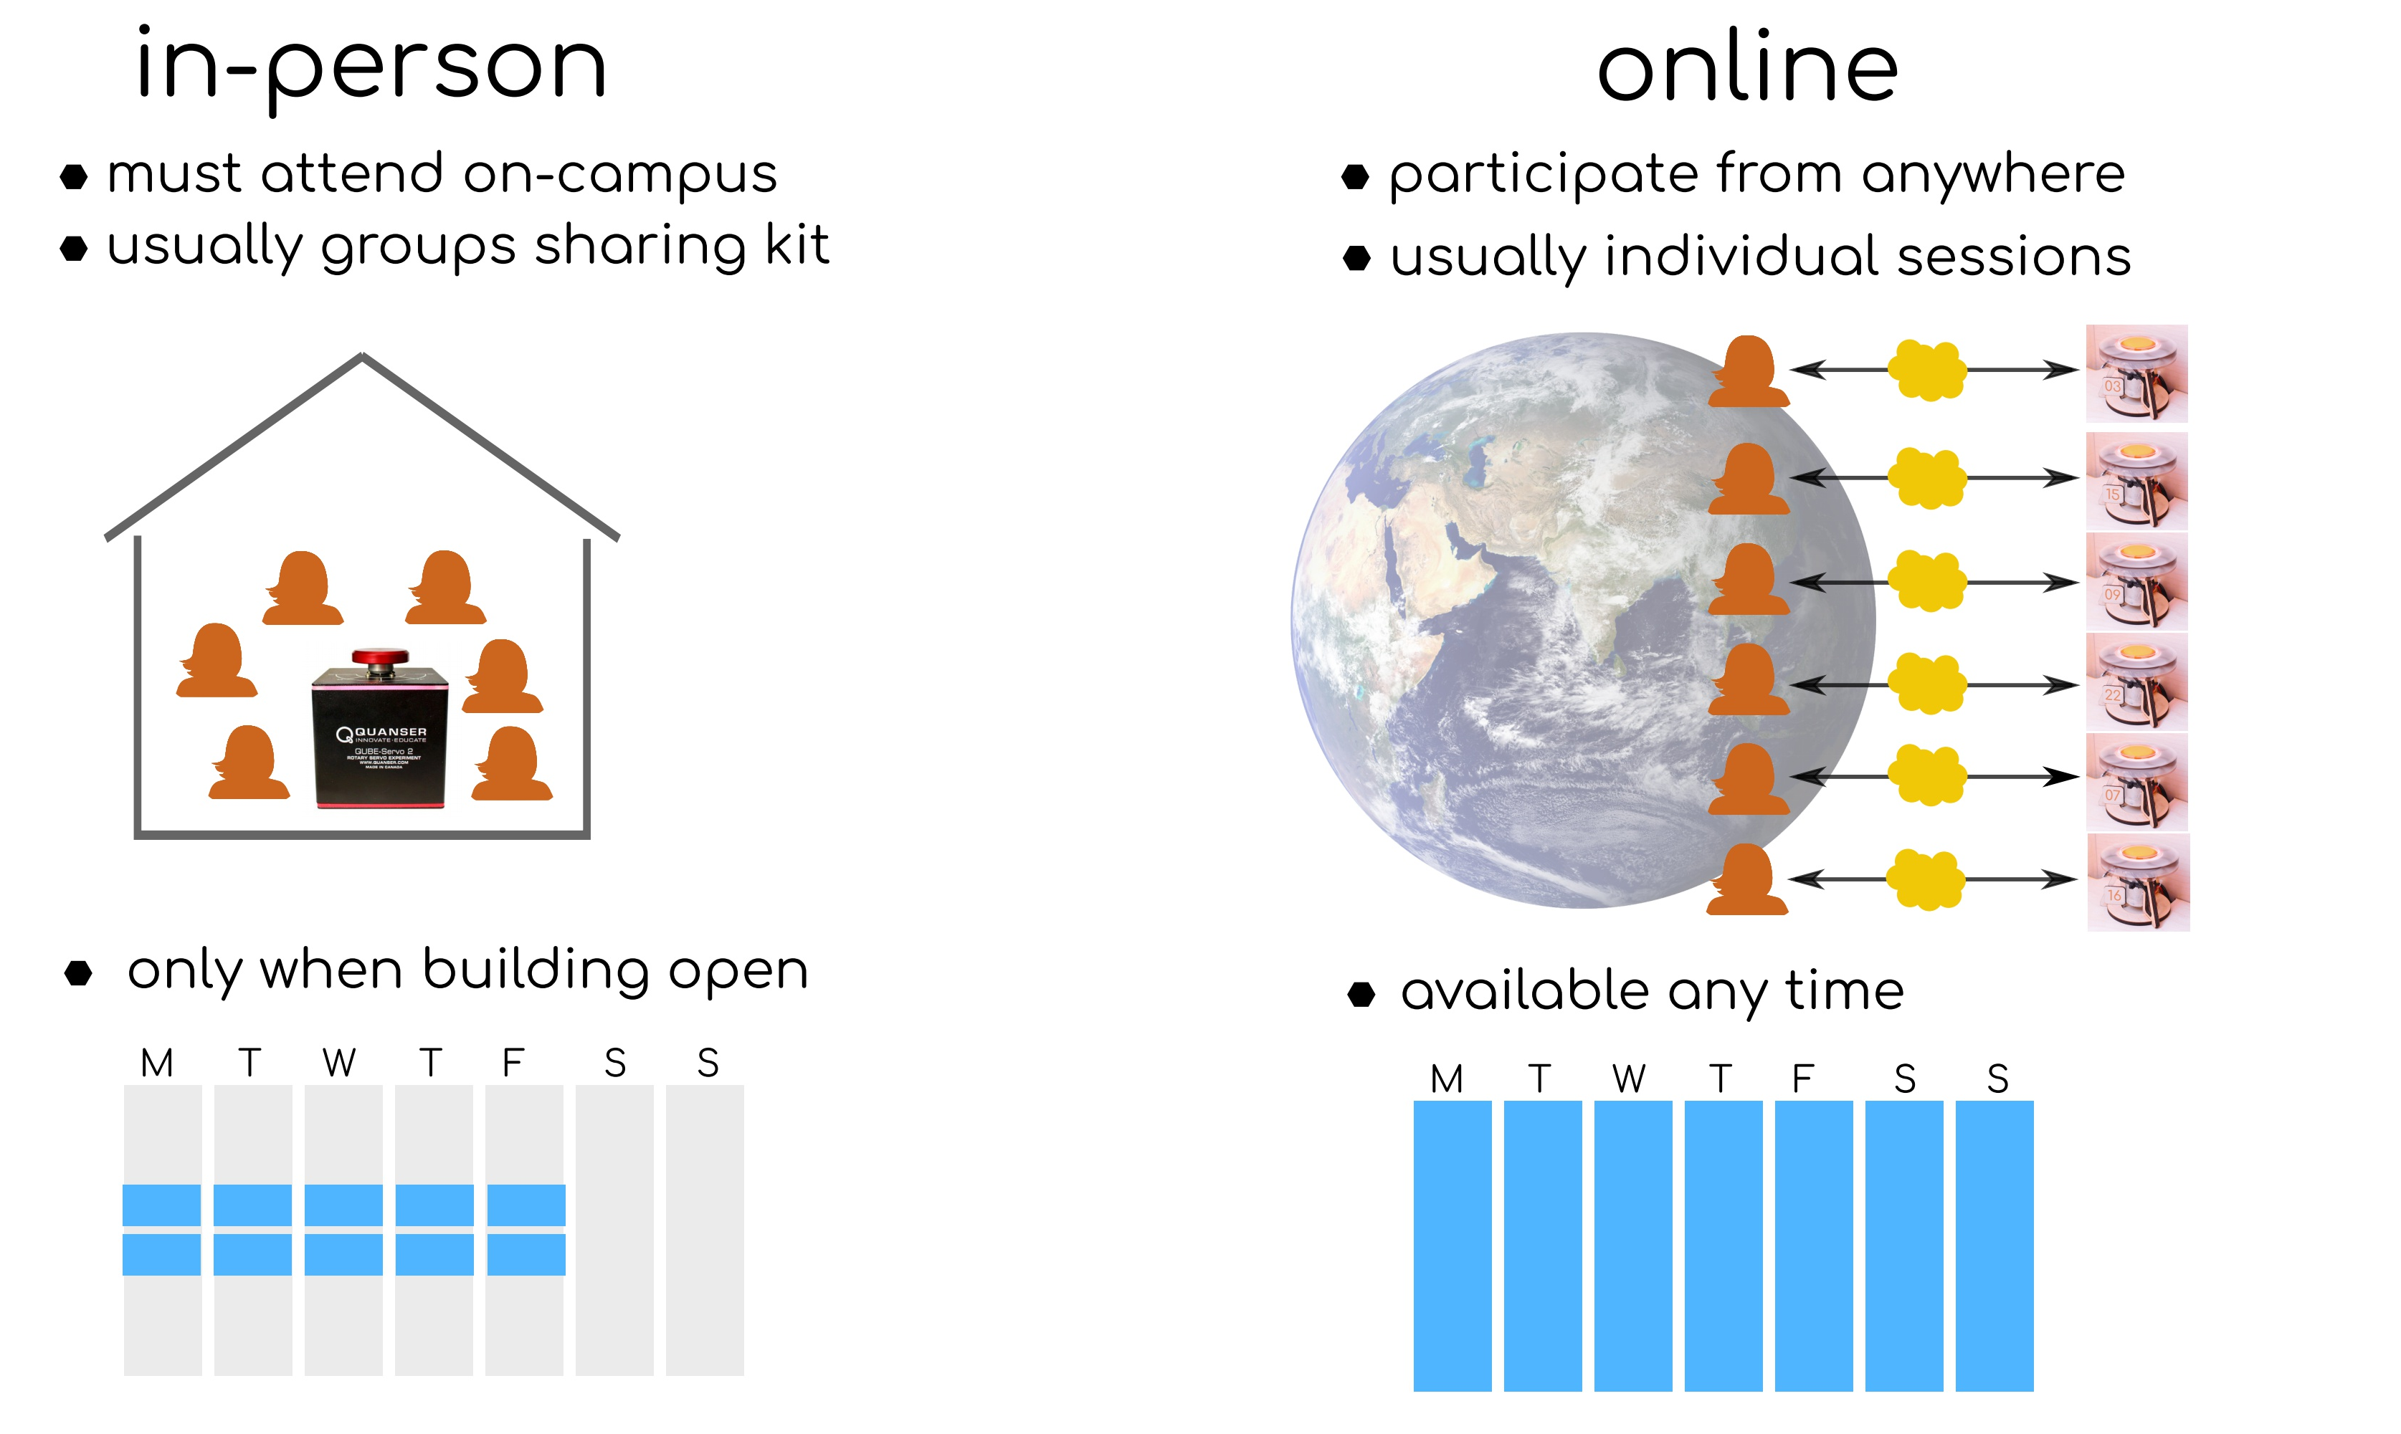

Slide 21
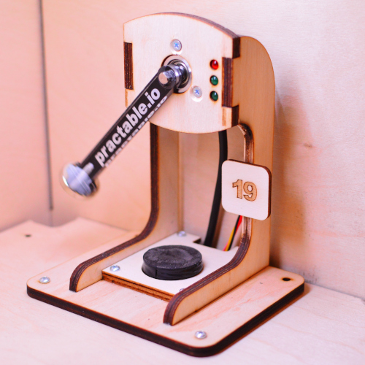
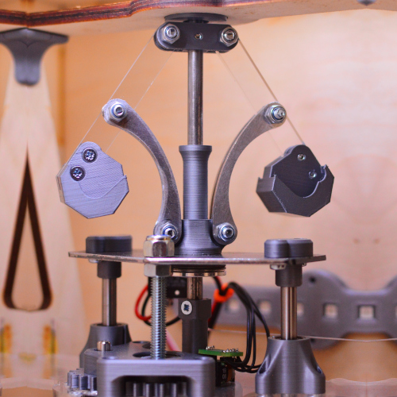
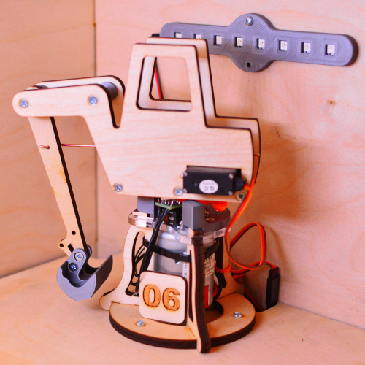
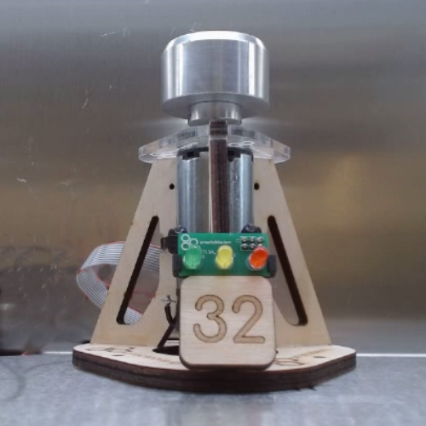
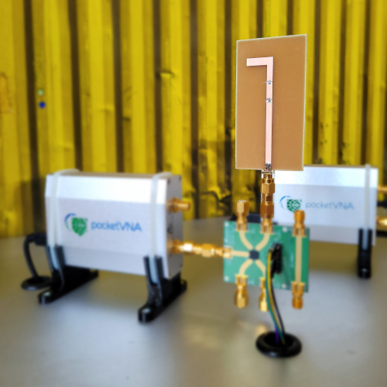
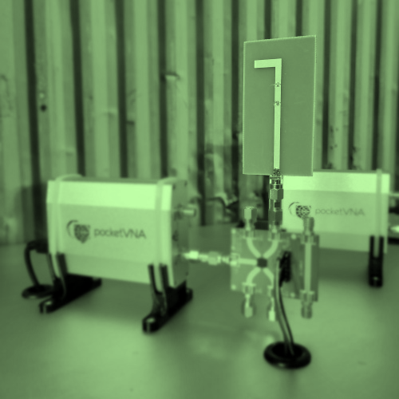
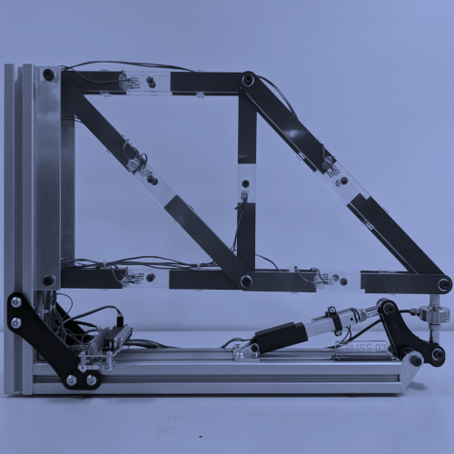
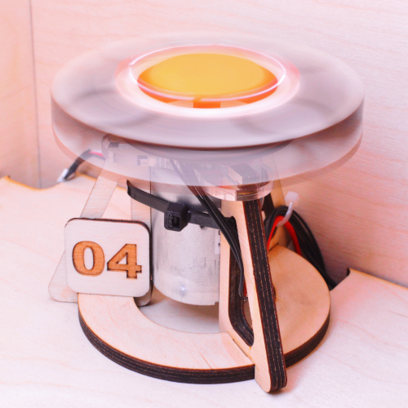
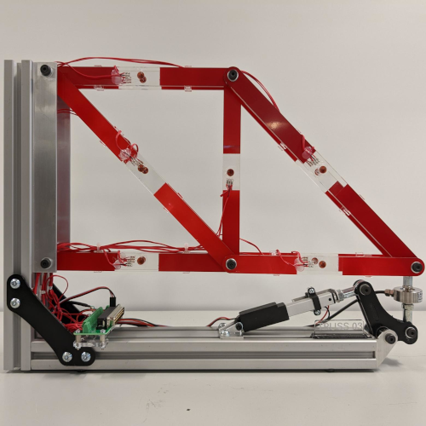
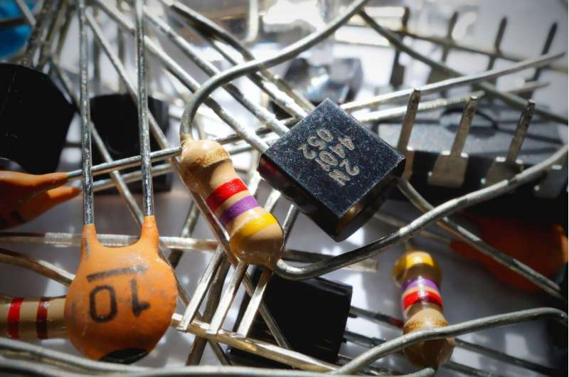
×10
×36
×10
×5
×48
×5
In build
x1
×16
x1
×8
×48
x1
×10

Slide 22
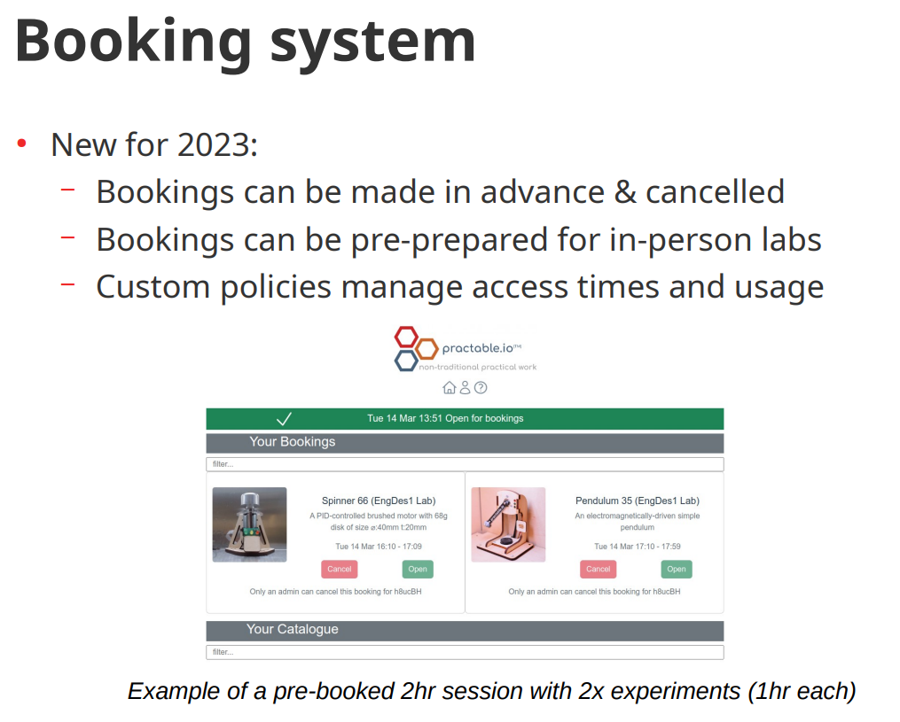

Slide 23
Student response (standard UEQ)
parameter | 2021 | 2022 | 2023
 | 3rd year (250) | 3rd year (250) | 1st year (450)
Attractiveness | positive | positive | positive
Easy to learn | positive | positive | positive
Dependability | neutral | positive | positive
Efficiency | positive | positive | positive
Stimulation | positive | positive | positive
Novelty | positive | neutral | neutral

Slide 24
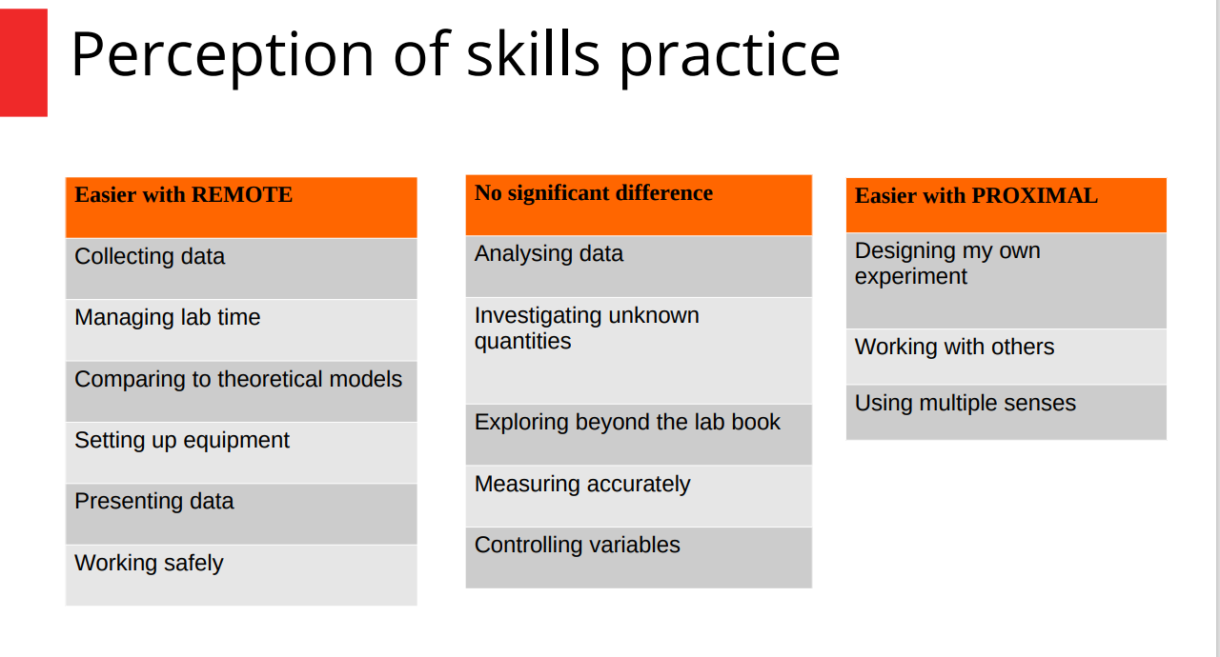

Slide 25
Student comments (2021 class)
-“It is a great tool, and made me feel more motivated than a purely simulated one would have.”
-“Ability to take multiple sets of data and “play” around with numbers to deepen understanding”
-“[I]t gave me more time to figure things out and feel like I really understood the content. The UI was also very easy to understand and clear.”
-“Able to proceed at my own pace; not feeling rushed and under pressure.”
Notes:
25

